Slide 1
Gesture Droid
Computer Science Project Endreport
Christoph Fuchs
Roman Hochstöger
Notes:
Hello everybody!
My name is Christoph and this is my colleague Roman and we both are going to present you today our practical training named “GestureDroid” and the results and conclusions we made during the work on this project.

Slide 2


Content
Introduction & Motivation
Used Hardware
Software
  Server program
  Evaluation of measured data
Problems
Conclusions
Notes:
First of all a few words about the content:
At the beginning we will give you a short introduction about what our project is about and present you the goals of the project. Second we are going to show you the hardware we’ve used and the software programs we’ve developed. In this particular case it’s about a server program and a program to analyze measure data. At the end we are going to showcase the occurred problems and the achieved conclusions.

Slide 3
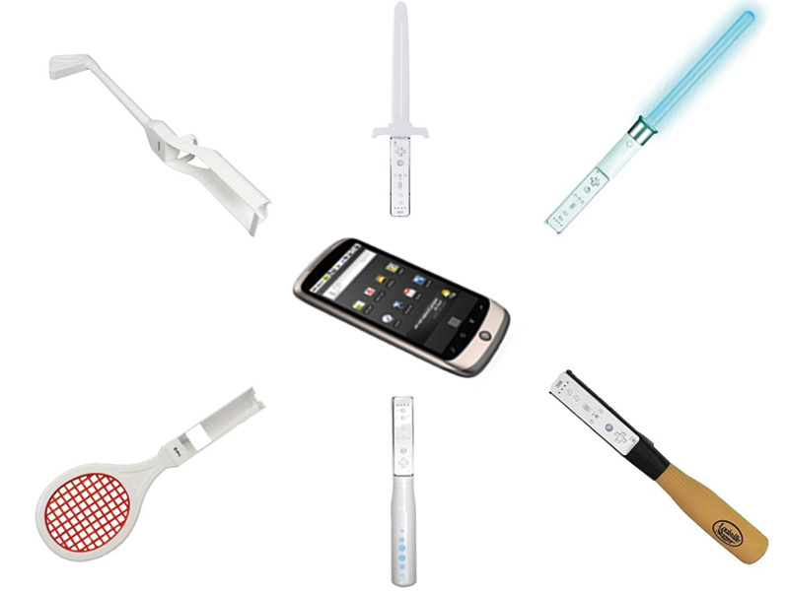

Motivation
Notes:
As we are all aware of, we use smartphones in different situations of daily life either meaningful or senseless. In some applications different sensors are used. It was our goal to research if it’s possible by means of data, which are delivered by the sensors, to classify an accomplished gesture. Furthermore we want to compare between smartphones and Wii-Remote, because Nintendo-Wii is able to recognize different movement patterns. We’ve measured different types of gesture (zum Beispiel der Umgang mit einem Schwert oder Golfschläger) and analyzed them afterwards, whereby there is one basic sequence:

Slide 4
Introduction
Movement of
  Smartphone
  Wii-Remote
Transmission of data to the server program
Analysis of movement data
Comparison of Wii-Remote and smartphone data
Notes:
First of all a gesture with the help of a smartphone and/or wii remote is executed. In the next step the data are delivered to the server program where they are also stored. These stored data are even available for an analysis and could also be used for a comparison between smartphone and Wii-Remote.

Slide 5
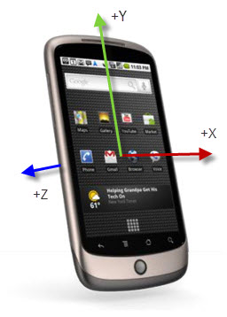
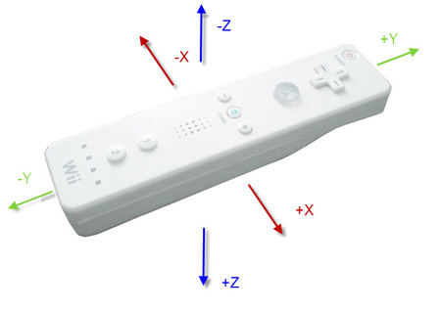
Hardware
Smartphone
  HTC N1 & HTC DESIRE
Wii-Remote
Notes:
We’ve used HTC N1, HTC Desire and also Wii-Remote for our measurements and gestures.
It’s important that the gesture is able to be measured by the sensors, because they do have a limited function range. In addition the gesture should be similar especially if the movement data are originated by different hardware types.

Slide 6
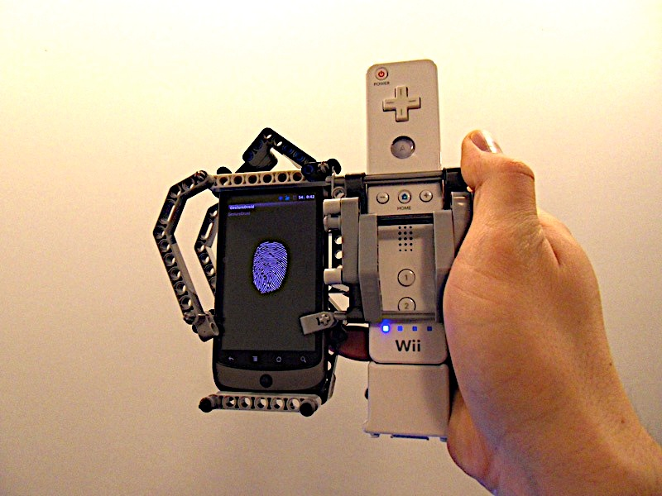
Mounting Device
Notes:
Most of all we were interested in comparing measure data between smartphones and Wii-Remote. In order to have approximately similar measure conditions we’ve developed the mounting device. (This is our mounting device. It is possible to fix one smartphone and one Wii-Remote at once on this mount. Due to this special mount two nearly similar gestures can be executed in one moment.)

Slide 7
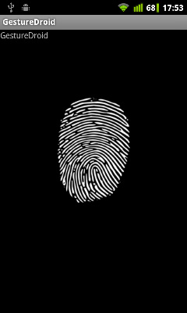
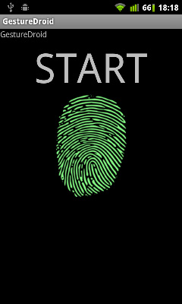
GestureDroid (Android-App)
Reads the sensors
Transmission of data to the server programm via TCP
Notes:
So, how are measure data determined? Therefore we have developed an Android application, which permits to start and finish a measurement of gesture. In this process the acceleration sensor and the orientation sensor are read every 20 milliseconds and the data are delivered to the server program via TCP-Connection.

Slide 8
Server Program (Java):
Connection via
  TCP (Smartphone)
  Bluetooth (Wii-Remote)
Visualization of the orientation
  Check of data connection
Notes:
The server program is able to receive measured data, where this data are either delivered by TCP-Connection for smartphones or Bluetooth for Wii-Remote.

Slide 9
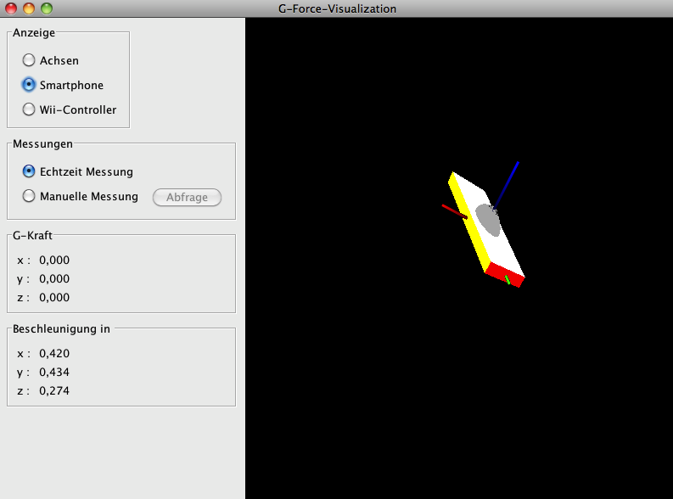
Server Program
Notes:
Furthermore current orientation of the hardware gets visualized in realtime. Now it’s possible to determine each point in time if data connection is active and after finishing a measurement data will be stored.

Slide 10
MATLAB Program
Multiple executions of one gesture
  Validation of testdata
Different gestures
  Feasibility of classification
Different hardware
  Comparison of sensordata
Notes:
ROMAN
The stored data can be visualized and analyzed with the help of our developed program in MATLAB. The main function of this program is to visualize different measurements of gestures to get the possibility to compare them easily.
On the one hand we’ve made a couple of measurements of one gesture, so we were able to validate the measured data. On the other hand we also executed different kinds of gesture to get the possibility to find out if a classification based on sensor data is possible. Additionally measurement was performed both smartphone and Wii-Remote to get a comparison of the sensor data.

Slide 11
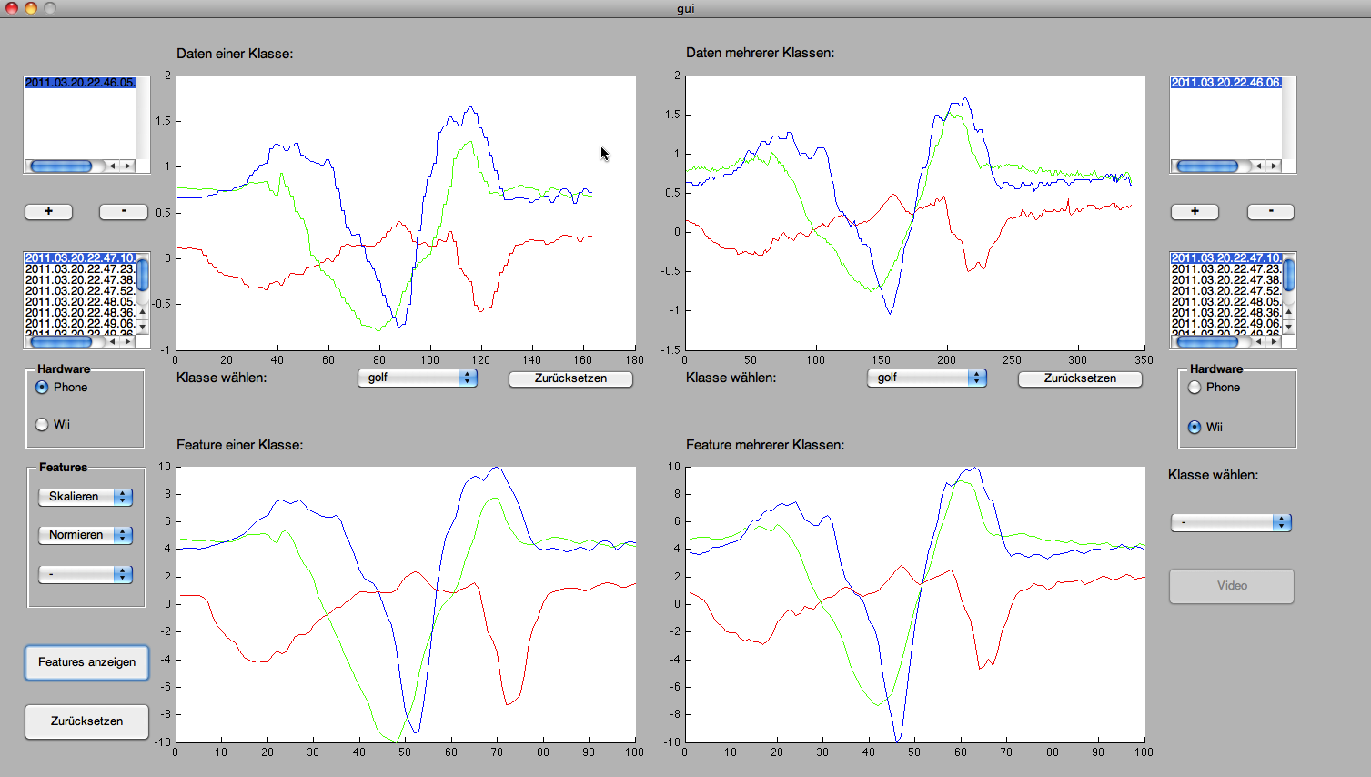
MATLAB Program
Notes:
Here you can see the interface of the MATLAB-visualization program.

Slide 12
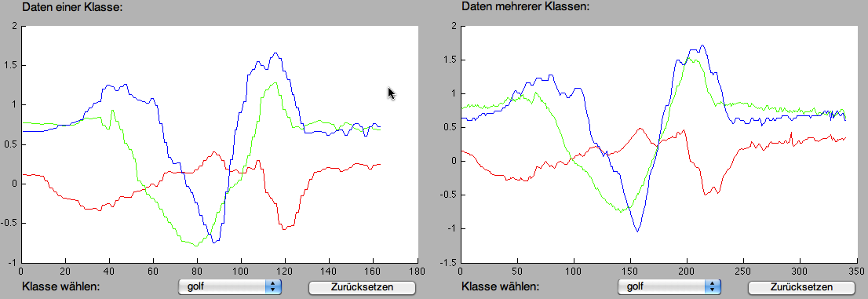
Results
Upper part
Smartphone Wii-Remote
Notes:
In the upper part of the interface measure data from different gestures can be selected and visualized. If you just look at these raw-data it’s difficult to compare them with each other, because they have a different number of measure points and a different measurement range. Moreover a measurement consists of three axes, which makes the visualization more complicated.

Slide 13
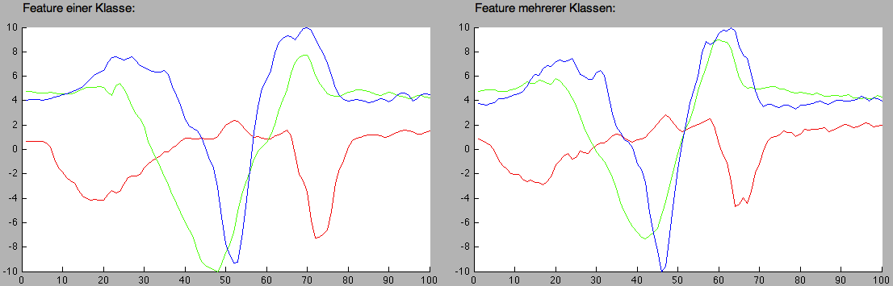
Results
Bottom part
Smartphone Wii-Remote
Notes:
That’s the reason why it is possible to visualize in the bottom part the measurements in a defined measure environment. Since every measurement now consists of the same number of data points and is located in the same measurement range, so it is much easier to compare between gesture measurements.

Slide 14
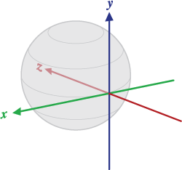
Problems
Evaluation of the orientation sensor
  Calculated by acceleration and compass
  Determination of orientation in space
Data connection between Wii and PC
  Driver problems in Windows
Measurement range of smartphones
  Movement velocity has not to be over 2g
the magnetic North Pole
the vector product Y.Z
points towards the center of the Earth
Notes:
But during our practical training some problems occurred. At the beginning we especially dealt with orientation of the smartphone in space during a movement. But the orientation will be calculated by considering a compass and the acceleration forces which affect the smartphone. During a movement the acceleration is changing and that’s the reason why orientation cannot be determined meanwhile.
|||||A further problem was the data connection between Wii and Pc. Especially if you are using Windows it’s just possible with a huge afford to establish a data connection. There are just a few Bluetooth adapters and drivers supported by the Motej API, which is necessary to read out the transmitted data of the Wii-Remote.
|||||Moreover it wasn’t always easy to perform a gesture with the smartphone which doesn’t exceed the range of the acceleration sensors. The smartphone sensor is only able to measure accelerations up to 2g and this isn’t really much. In our Android application we implemented an acoustic warning signal to inform in case of an exceed.

Slide 15
Conclusions
Orientation of smartphones in space during movement is difficult to determine
Newer hardware also uses Gyroscopes
Acceleration sensors of Wii-Remote and Smartphones deliver similar messure data
Wii games do not perform classification
Choice of classification algorithm not obvious
Notes:
To sum up, I can say that it’s pretty difficult to determine the orientation of the smartphone in space during a movement. Possibly a Gyroskop would help. (By the way the Wii-Motion-Plus is using such a gyroskop to determine the orientation.)
|||||Finally we came to the conclusion that the acceleration sensors of Wii-Remote and smartphones are delivering similar measure data. The pros of the Wii-Remote are a higher resolution and an improved measurement range about 3g.
|||||Anyway there is no direct classification of movement in Wii games which is perhaps down to the fact that
|||||it is very difficult to realize it just on the basis of acceleration data.

Slide 16
Thank you for your attention!
Notes:
Are there any questions left? Otherwise we’d like to thank you for your attention.

